Slide 1

AlphaBoom
TRADING ALGORITHM
LIU, Dingdong
ZHOU, Shixu
FENG, Jinglong
FENG, Xinyu
Notes:
Good afternoon, everyone! This is team AlphaBoom from HKUST. Without further ado, let me display our trading idea – a machine learning based trading algorithm in Forex market.

Slide 2
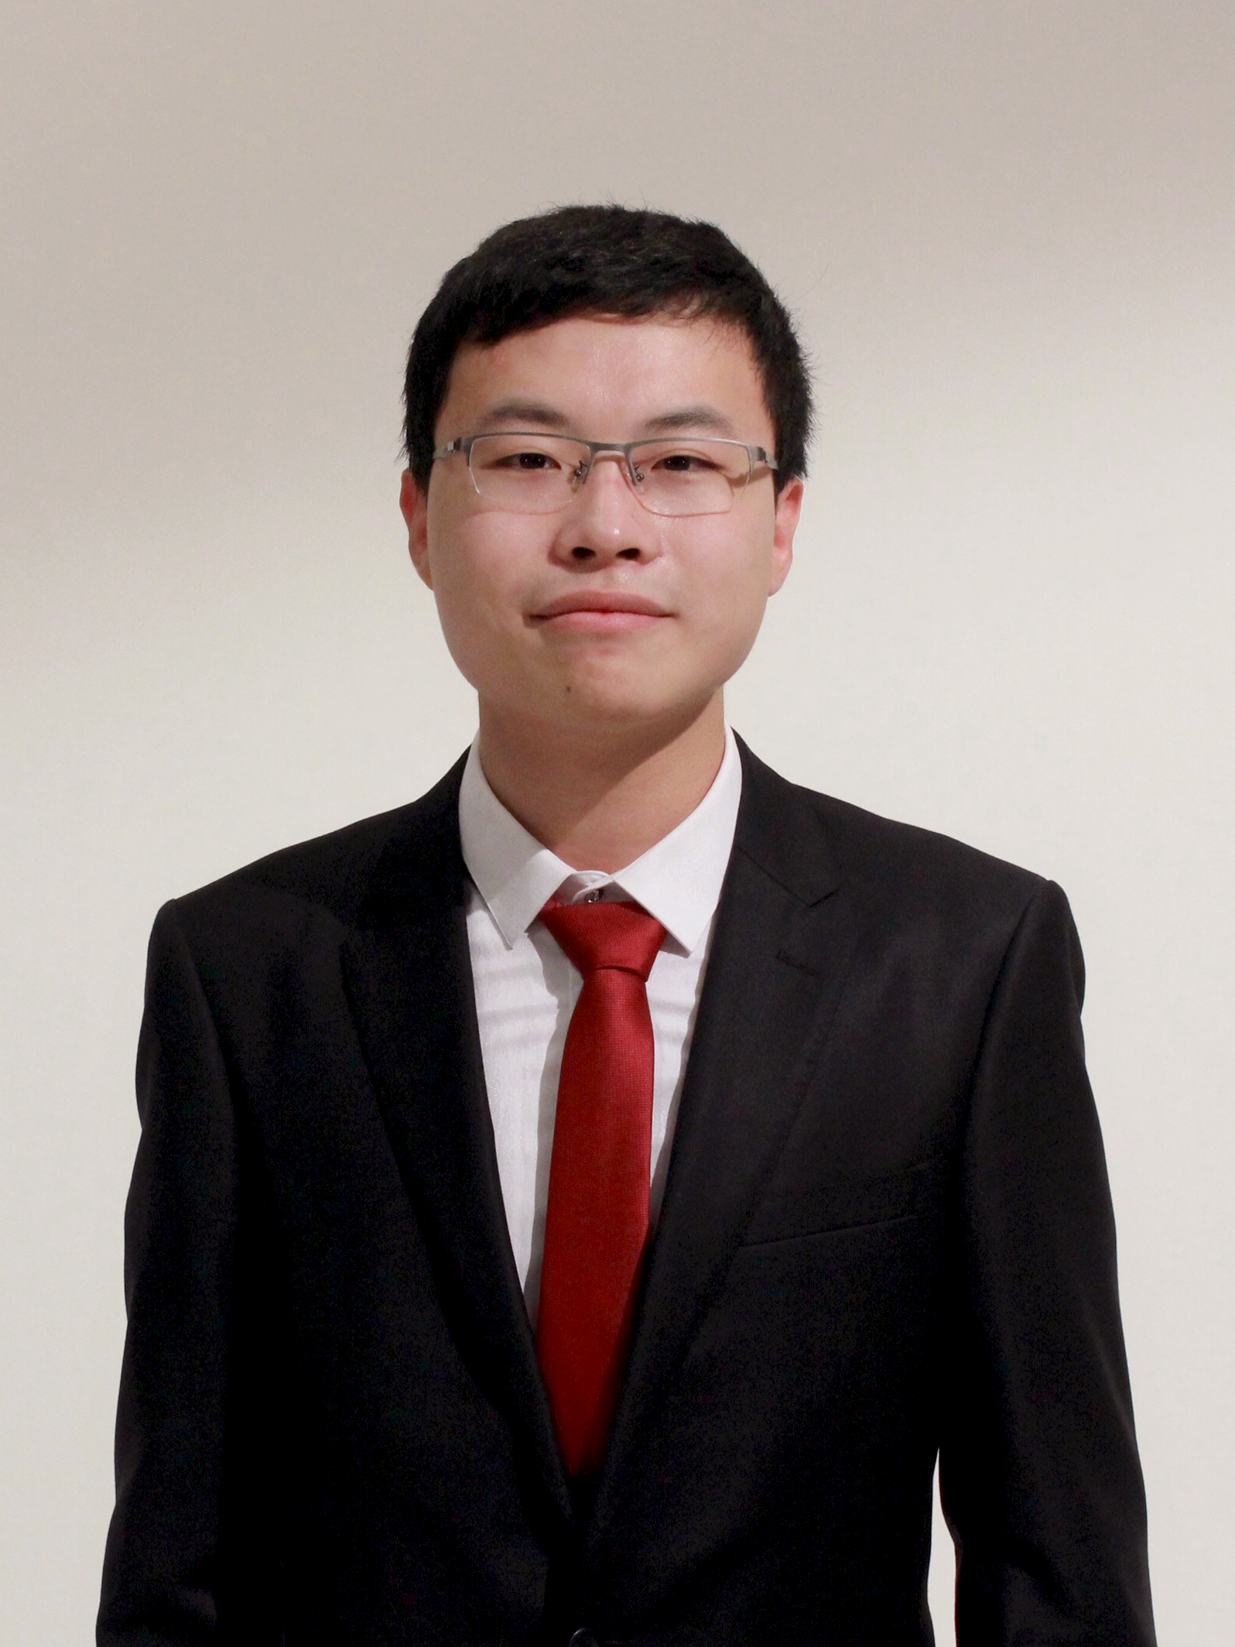
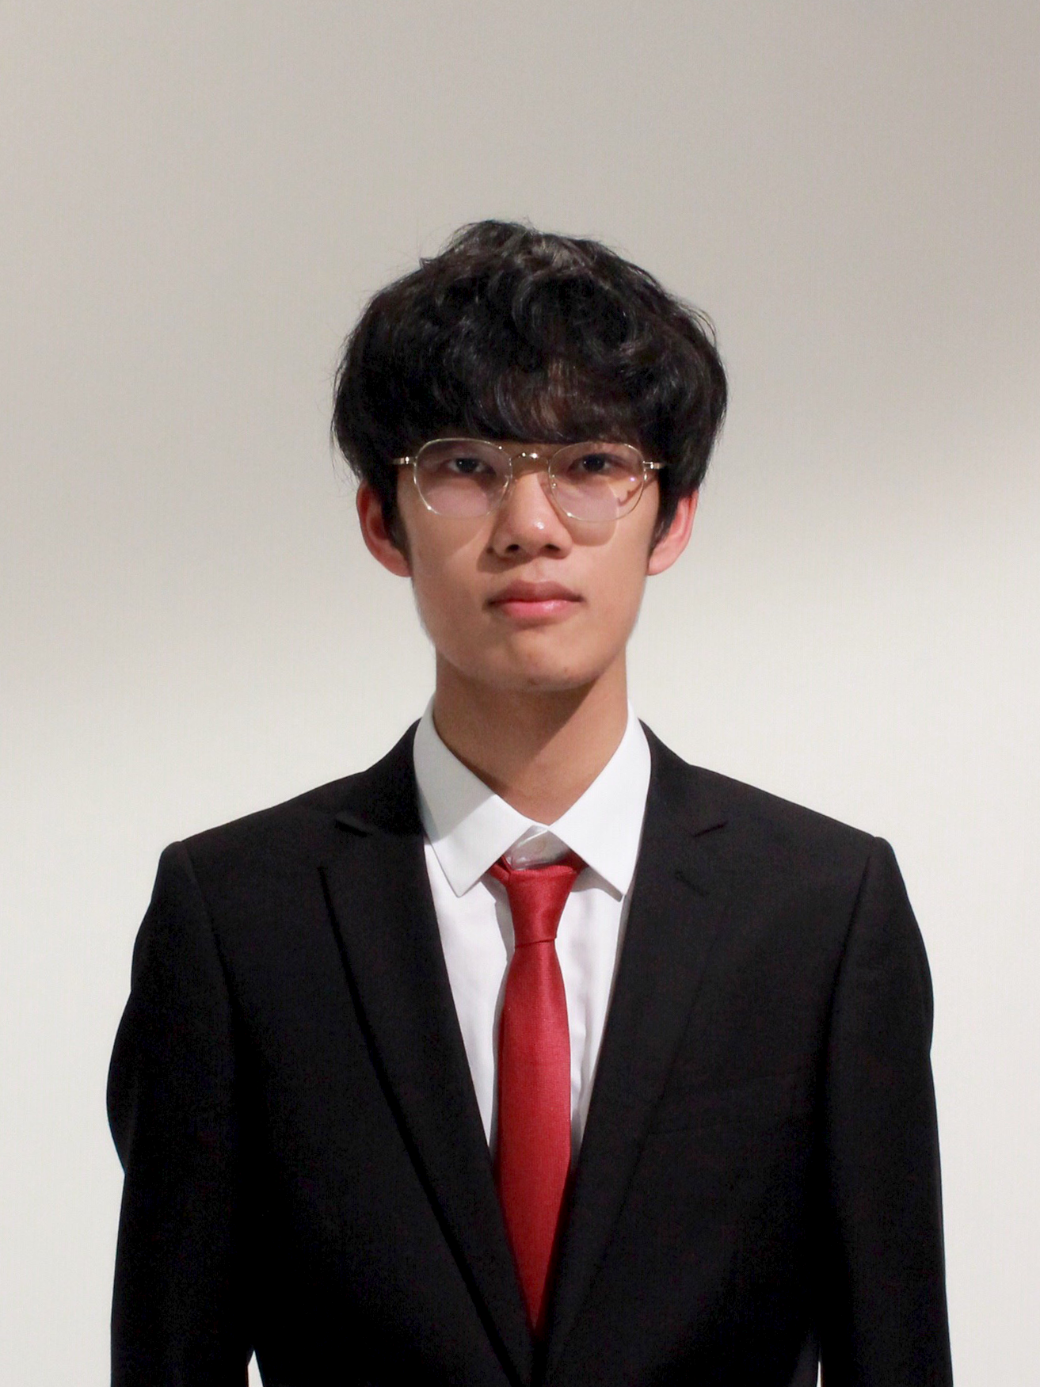
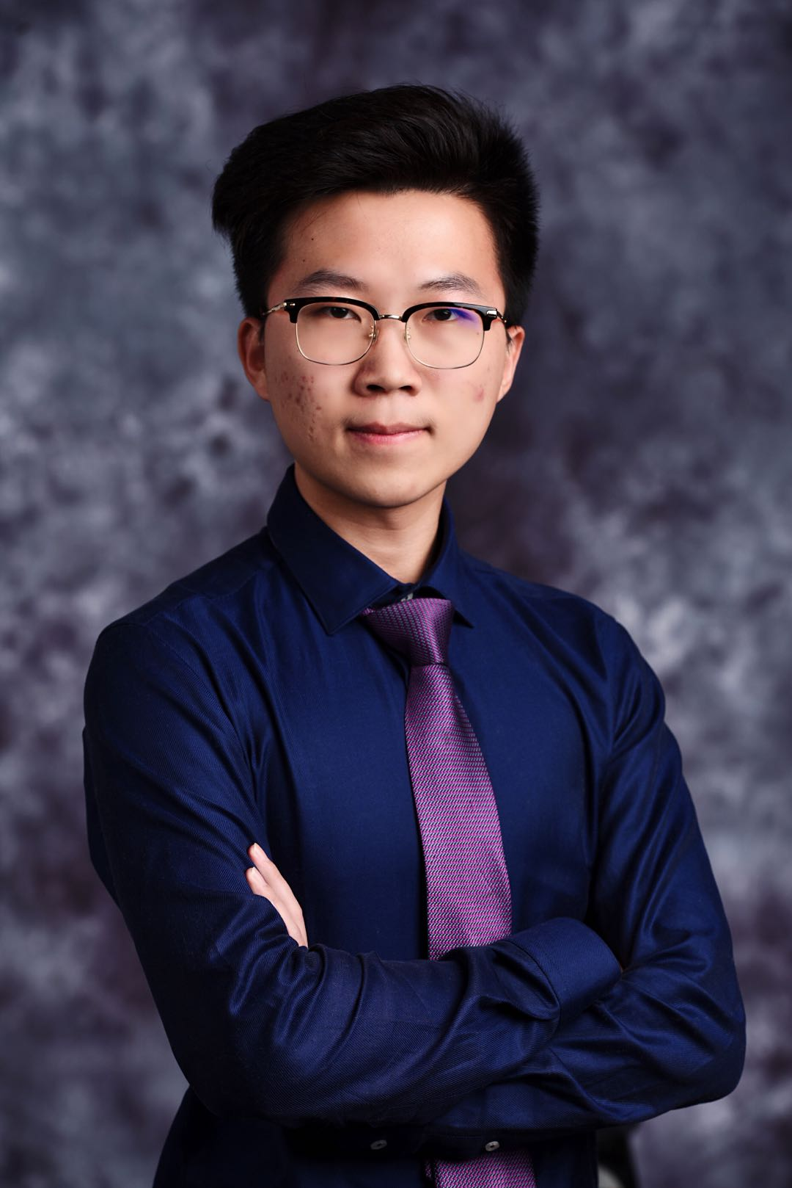

Teammates
LIU, Dingdong
ZHOU, Shixu
FENG, Jinglong
FENG, Xinyu
BSc Computer Science
+Data Science
BSc Mathematics
+Computer Science
BSc Quantitative Finance
BBA Accounting
+Operation Management
Notes:
These are our team members. We are students from computer science, math, quantitative finance and accounting. This helps us to develop high performance algorithm.

Slide 3
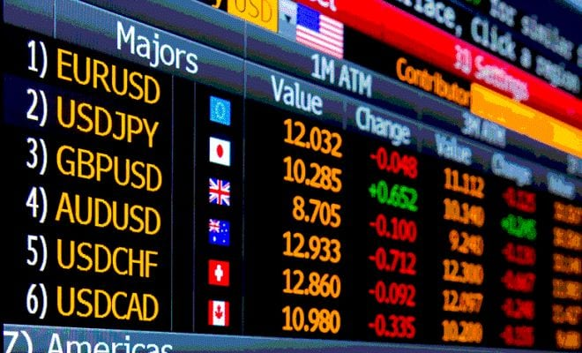
Market Selection
High Flexibility
Operates 24-7. Investor can enter or exit a trade whenever they want.
Low Transaction Cost
Only require traders to pay the spread. This supports high trading frequency.
Temporal Locality
Data has pattern is likely to happen in the future. Observed within the dataset.
Forex Market
Notes:
Before diving into the real algorithm, it’s necessary to first have a look at the forex market that we have chosen. By industrial research, in 2019, around 92% of trading in the Forex market was performed by trading algorithms, partially owing to its high flexibility and low transaction cost. Another main advantage of this market is the temporal locality we discovered during feature engineering process. This helped us to develop a profitable algorithm.

Slide 4
Trading Idea
0
1
0
2
0
3
PREDICTION
DECISION
TRADING
Predict the future market price, model selection etc.
Decide the volume that will be traded, manage risk etc.
Trigger a trade utilizing the platform provided to us.
Notes:
Let’s have a closer look at our trading idea. Our trading process can be divided into 3 modules, namely prediction, decision, and trading. While the trading module is provided by algogene, let have a look at the first two modules.

Slide 5
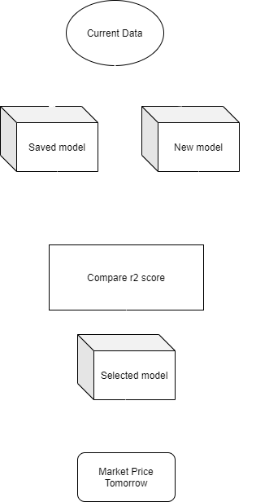
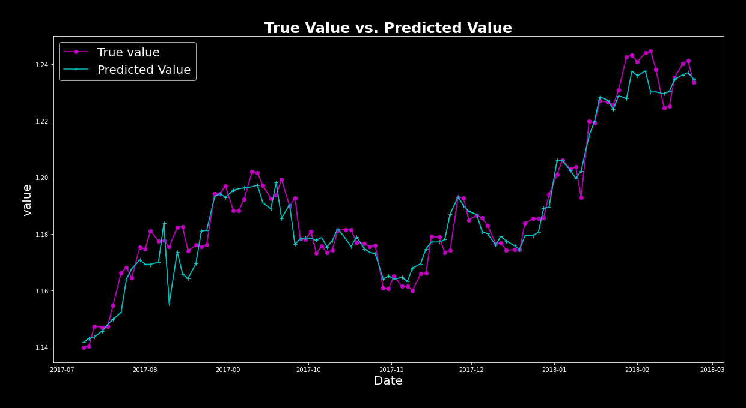
Prediction
Notes:
Prediction module utilized current data to predict market price tomorrow. We also adopt a “model selection” method. This is a selection over a pre-trained saved model and a model trained on the go. We select a better model based on R2 score on the test set. If the R2 score is less than 0.6, we will prevent trading due to lack of confidence. The right-hand side displays a picture of our model fitting. As you can see, the error is less than 1%

Slide 6
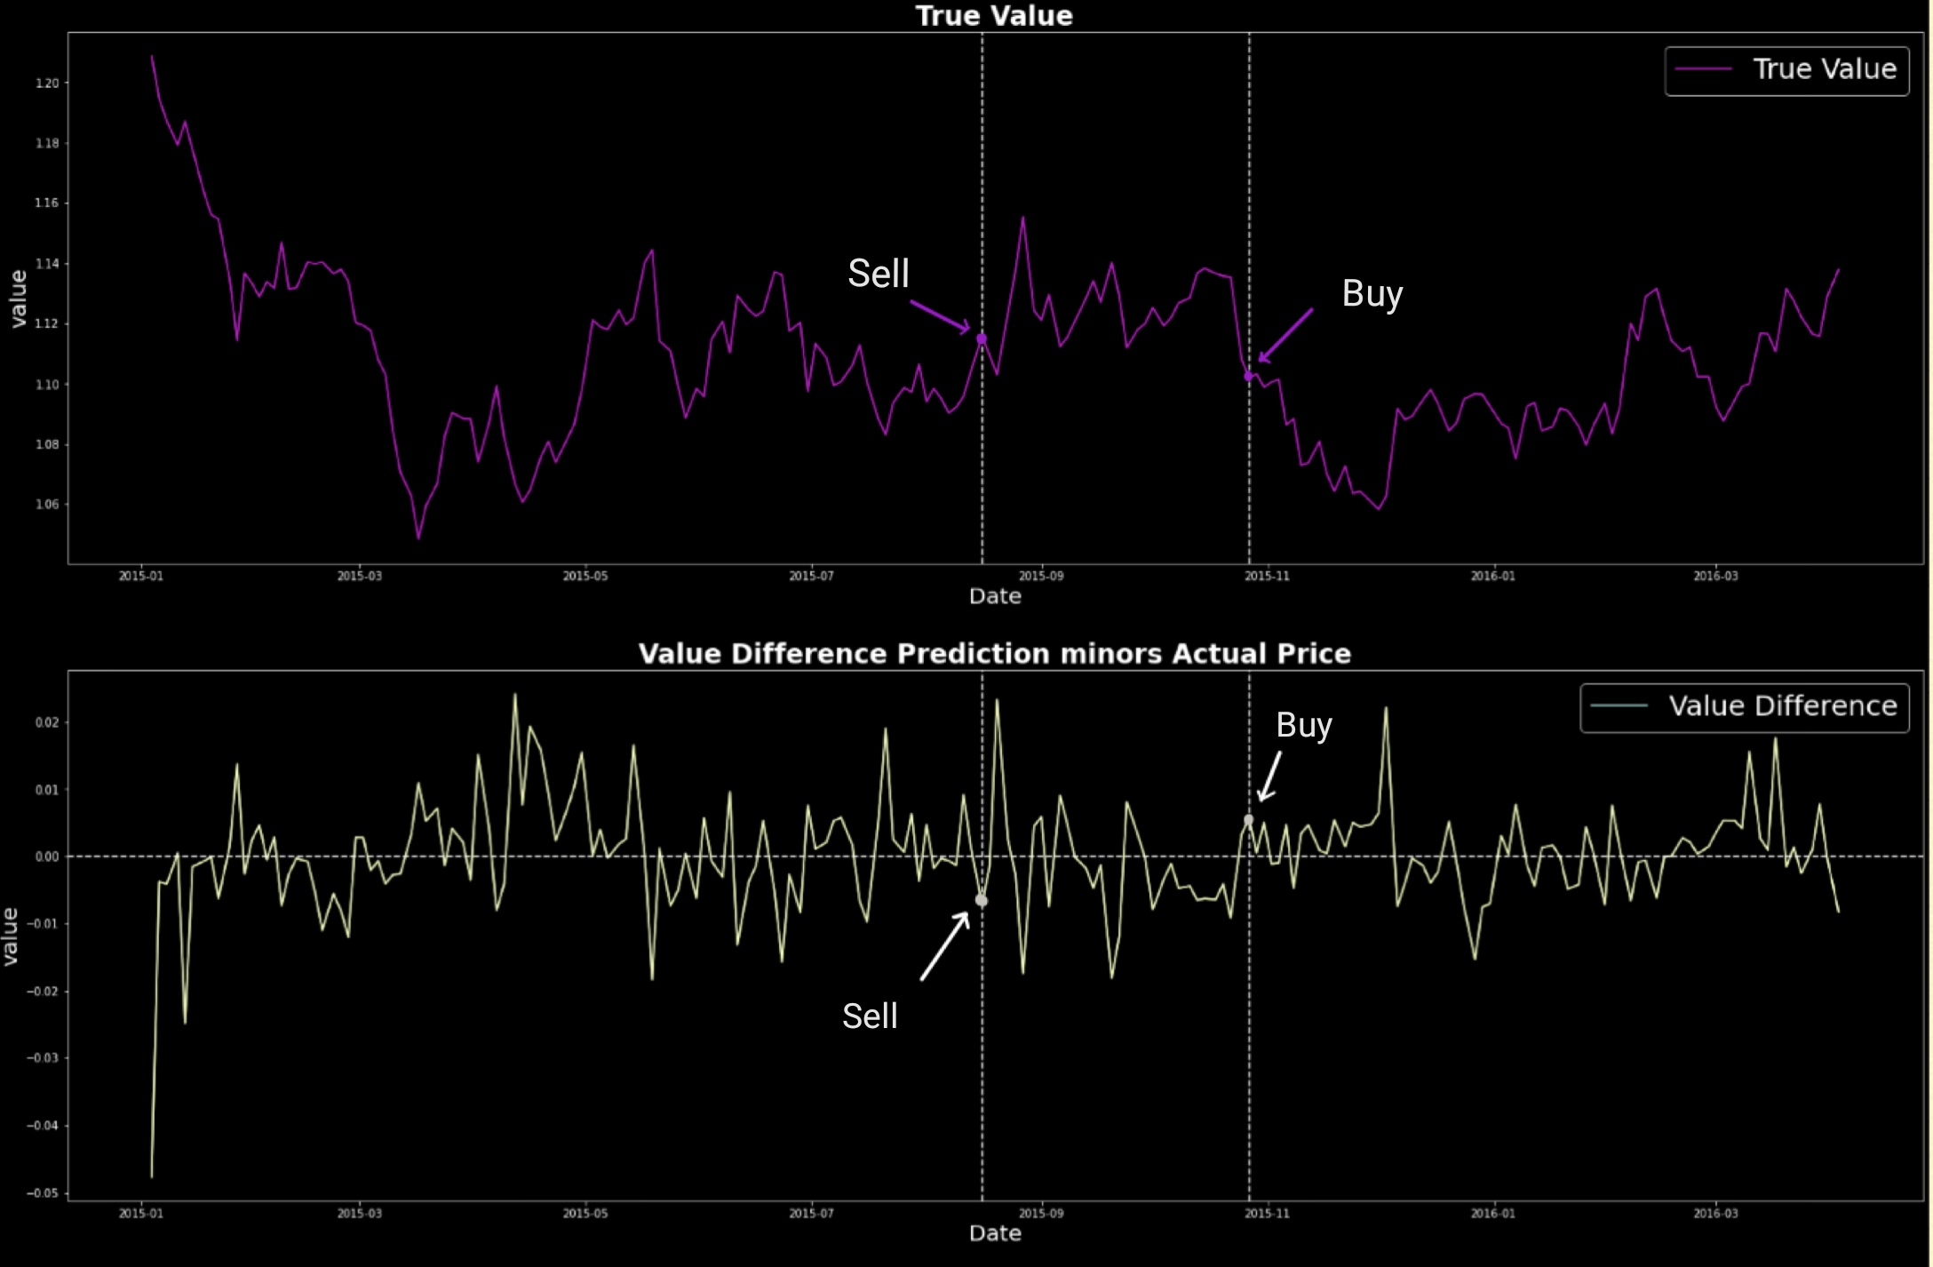
Decision - Trading Strategies
01
Core Idea
“Buy Low Sell High”
– decide when to trade
02
Volume
Decide trading volume based on absolute error
Notes:
The decision module contains trading strategy and capital management. As for our trading strategy, we simply used the “buy low sell high” method. This tells us when to trigger a trade. This simple, but stable.

Slide 7


Decision - Capital & Risk Management
Total Risk
$$Ideal Volume= \frac{Trade Risk}{Account Risk}≈\frac{Money at Risk∗}{Cents at Risk∗}$$
*Money at risk – 0.01 (SD of Residual)
*Cents at risk – Difference between predicted price and actual price
Trade Risk
Account
Risk
$$Estimated Volume=\frac{Risk Ratio}{\left|Predicted Price−Actual Price\right|}$$
Notes:
To decide the trading volume. We used the Risk model. In this model, total risk is divided into trade risk and account risk. The ideal trading volume can be calculated as their ratio. These two factors can be estimated by money at risk and cents at risk, which in our model, is estimated by risk ratio and difference between predicted price and actual price.

Slide 8
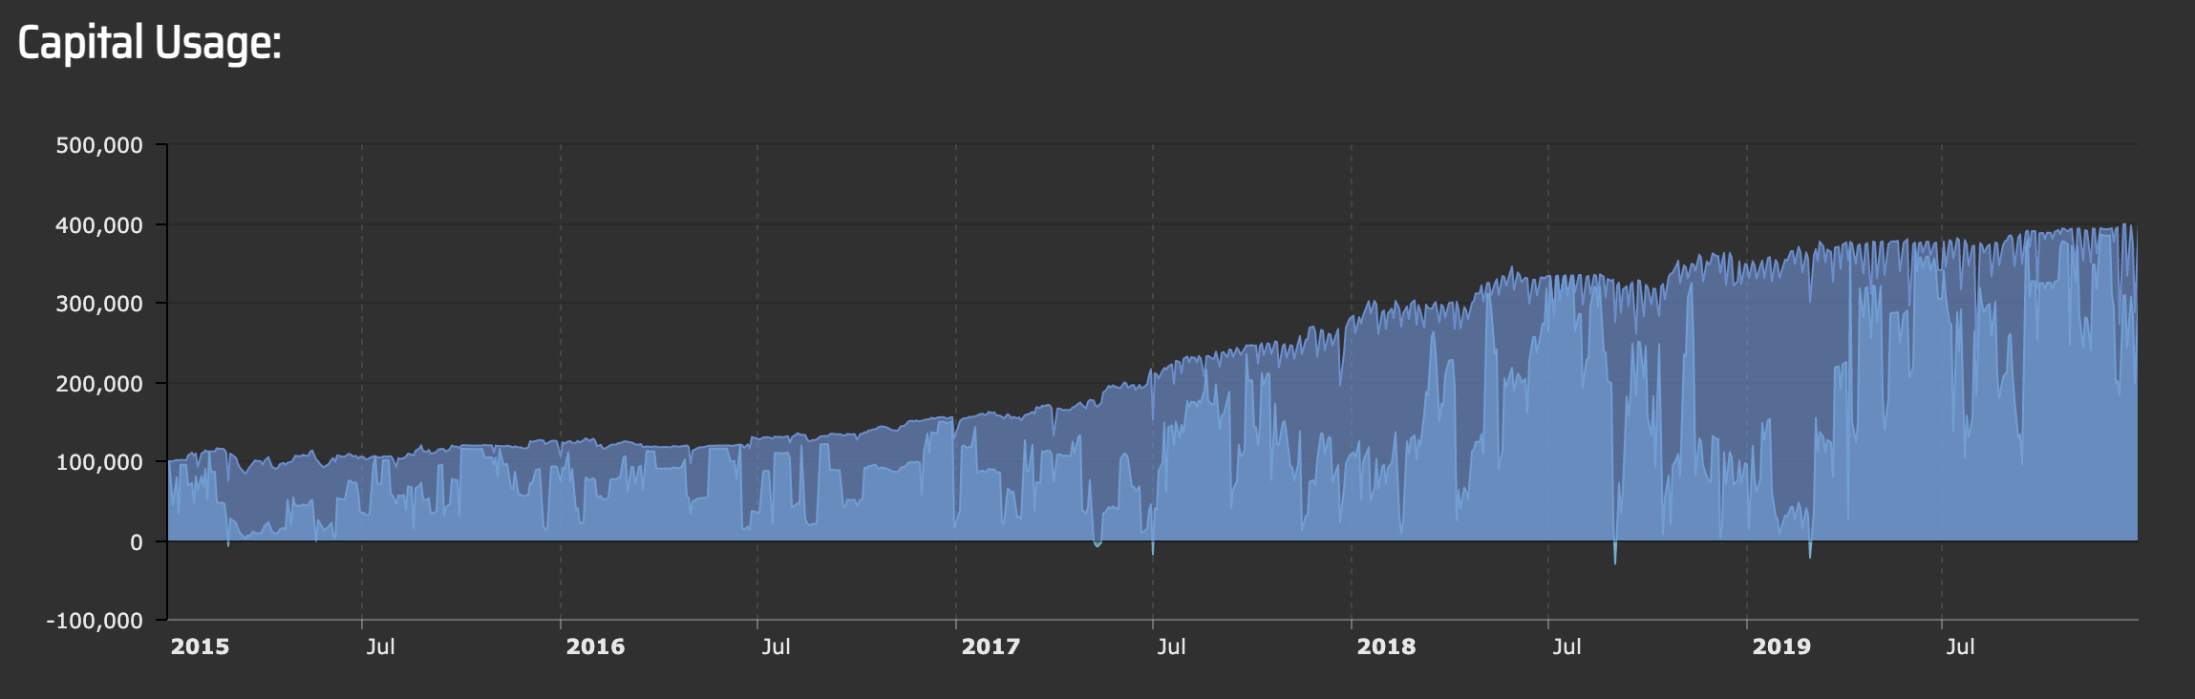
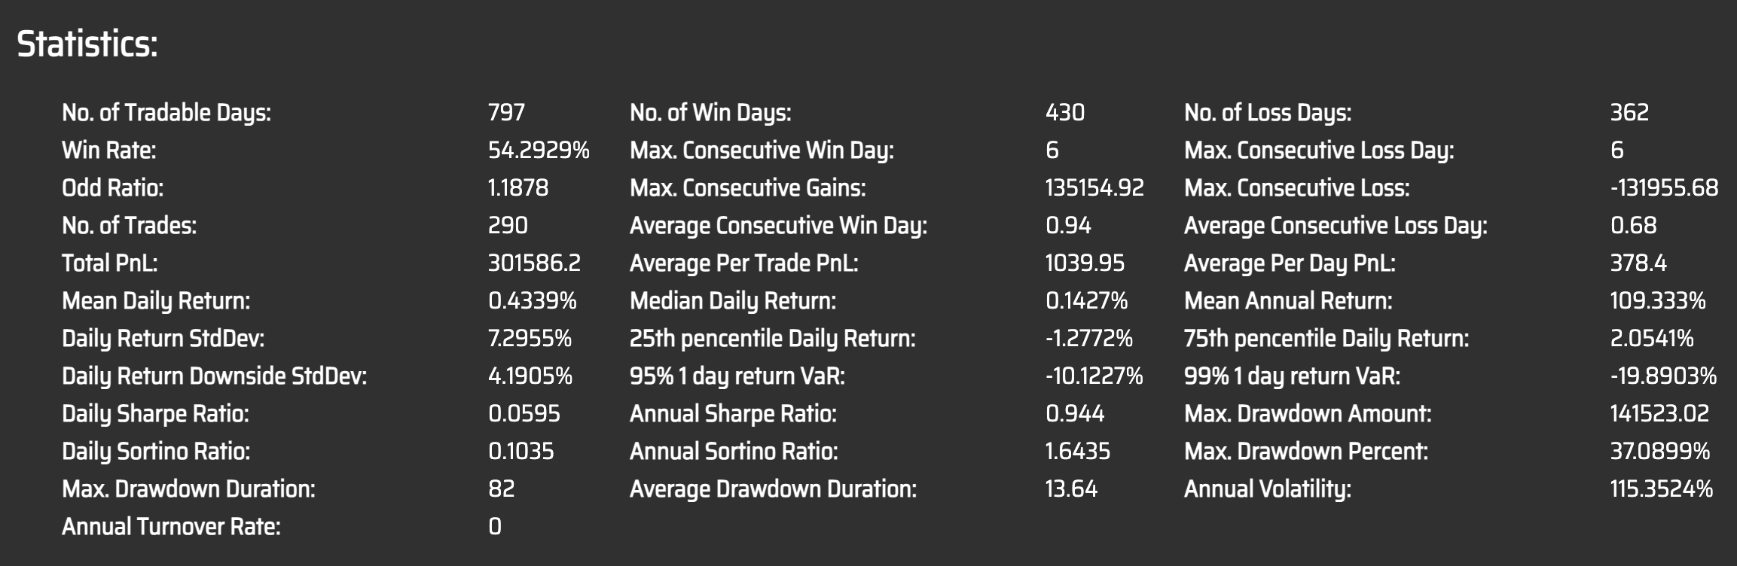
Notes:
Now let’s look at the back test performance. Here are a few highlights:
Annual sharp ratio of 0.944. Considerably good performance.
Number of trades and Annual return. The trading frequency is about one trade every 4 days. But we still earn more than one-fold a year. This relatively low frequency trading saves transaction costs and boosts profits.
Capital curve. The model performs reasonably well over different time horizon under various market conditions, which indicated a high consistency score.
Average drawdown duration. This suggests common recovery period from the latest lost, reducing the liquidity pressure from potential margin calls.

Slide 9
Competence
Modular
Sharpness
Easy to debug and upgrade. Replace module to react to market change.
Sharp ratio = 0.994. Good compensation for every percent volatility
Accuracy
Profitability
Gain R2 score over 0.7/1.0 on test set. MSE is less than 0.001
Earns more than one-fold per year. Low leverage value (leverage=5).
Mature Market
Security
Forex market is popular and mature in using trading algorithm.
Make confident trades. Simple trade logic. Two “gates” to prevent unconfident trades.
Notes:
Now let’s have a brief summary of our advantages. First is the modular design. We can easily upgrade our prediction module to deal with market change. Second is the accuracy. Our model gains R2 score more than 0.7/1.0 on test set. MSE is less than 0.001. The Forex market is mature for algorithm trading. And our algorithm is sharp and profitable. The last thing I want to mention is the security. In both prediction module and decision module, we have techniques to prevent unconfident trades.

Slide 10
TRADING ALGORITHM
THANKS
Notes:
That’s all of our presentation, thanks for listening!

Slide 12
Notes:
Financial analysis of result

Slide 13
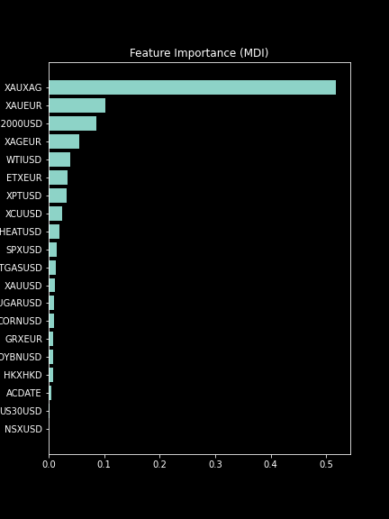
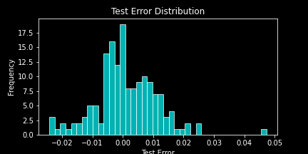
Residual Analysis
The residual is normally distributed (5%, AD test), which indicate that the variance is well described by the given function.

Slide 14
Accurarcy

Slide 15
